Slide 1
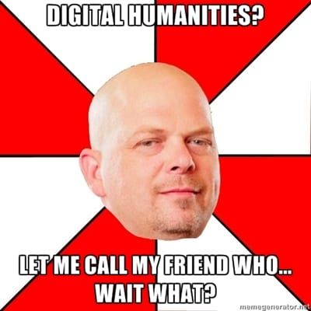


Slide 2
Welcome to
Introduction to Digital Humanities (Get to Know Each Other)
Shanmugapriya T
shanmugapriya@iitism.ac.in

Slide 3
Units
1. What is Digital Humanities?
Historicity
Debates and challenges
Various functions including data, openness, collaboration etc.
Western, global south and Indian contexts
Any other relevant arguments, analyses, and details

Slide 4
2. Text Mining
What is text mining?
Advantages and disadvantages
Use cases
Tool demonstration
3. Mapping
What is mapping?
Advantages and disadvantages
Use cases
Tool demonstration

Slide 5
4. Network analysis
What is network analysis?
Advantages and disadvantages
Use cases
Tool demonstration
5. Data visualization/Digital Storytelling
What is data visualization/digital storytelling?
Advantages and disadvantages
Use cases
Tool demonstration

Slide 6
Teaching method
Shared experience, discussion and exploration and any form of communication both offline and online
Meeting through appointment via email : shanmugapriya@iitism.ac.in

Slide 7
Assignment
Blog writing: Reflective essay
Collaborative data preparation for each method and experimenting it during the tutorial

Slide 8
Assignment criteria and rubrics
1. Blog: 500 words–per week
No AI assistant. But if you sought its assistance, explanation and citation are required
A successful blog:
should reflect your own perceptions of the topics we discussed in the class
meets the required length of 500 words
can include visuals and other graphic element

Slide 9
2. Collaborative data preparation for each method and experimenting it during the tutorial
After deciding the collaborators based on the diverse skillsets:
Step 1: Prepare values statement
Step 2: Data curation/collection online and offline
Step 3: Experiment with it during the tutorial class
Step 4: Once the final product is ready, we can display it on our website and disseminate it through our various channels and networks
Step 5: At the end, a report should be prepared based on your experience in terms the entire process, including the challenges, collaboration experiences, and your individual experience in developing new expertise etc.

Slide 10
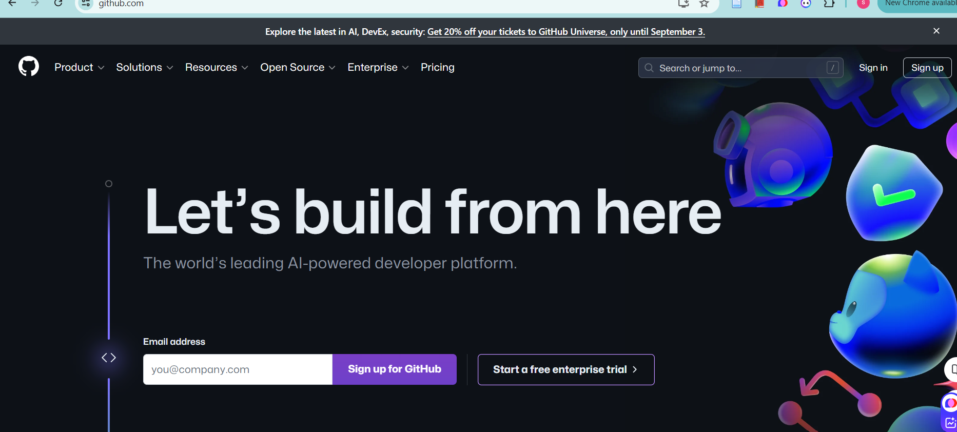
Entire course materials and other excercises

Slide 11
History of Computer
Video

